Slide 1
OVERVIEW OF C

Slide 2
INTRODUCTION
C language is one of the most popular computer language today because it is a structured,low level ,machine dependent language
• It is developed by DENNIS RITCHIE in between 1969 and 1973 at bell labs.
C language was developed with UNIX operating system, so it is strongly associated with UNIX, which is one of the most popular network operating system in use today and heart of internet data superhighway.

Slide 3
History of C Language
C language has evolved from three different structured language ALGOL, BCPL and B Language. It uses many concepts from these languages and introduced many new concepts such as data types, struct, pointer.
In 1988, the language was formalised by American National Standard Institute(ANSI).
In 1990, a version of C language was approved by the International Standard Organisation(ISO) and that version of C is also referred to as C89.

Slide 4
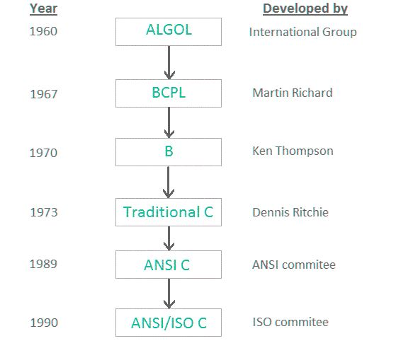

Slide 5
CHARECTERISTICS
There are a small, fixed number of keywords, including a full set of flow of control primitives : for, while, if, do while and switch.
• More than one assignment may be performed in a single statement.
• There are a large number of arithmetical and logical operators, such as +, +=, ++, &, ~, etc.

Slide 6
Structure/procedure oriented programming languages like C programming language follows top down approach. Whereas object oriented programming languages like C++ and Java programming language follows bottom up approach.
Top down approach begins with high level design and ends with low level design or development. Whereas, bottom up approach begins with low level design or development and ends with high level design.
In top down approach, main() function is written first and all sub functions are called from main function. Then, sub functions are written based on the requirement. Whereas, in bottom up approach, code is developed for modules and then these modules are integrated with main() function.

Slide 7
PROCEDURAL ORIENTED PROGRAMMING | OBJECT ORIENTED PROGRAMMING
In procedural programming, program is divided into small parts called functions. | In object oriented programming, program is divided into small parts called objects.
Procedural programming follows top down approach. | Object oriented programming follows bottom up approach.
There is no access specifier in procedural programming. | Object oriented programming have access specifiers like private, public, protected etc.
In procedural programming, overloading is not possible. | Overloading is possible in object oriented programming.
Examples: C, FORTRAN, Pascal, Basic etc. | Examples: C++, Java, Python, C# etc.

